Slide 1
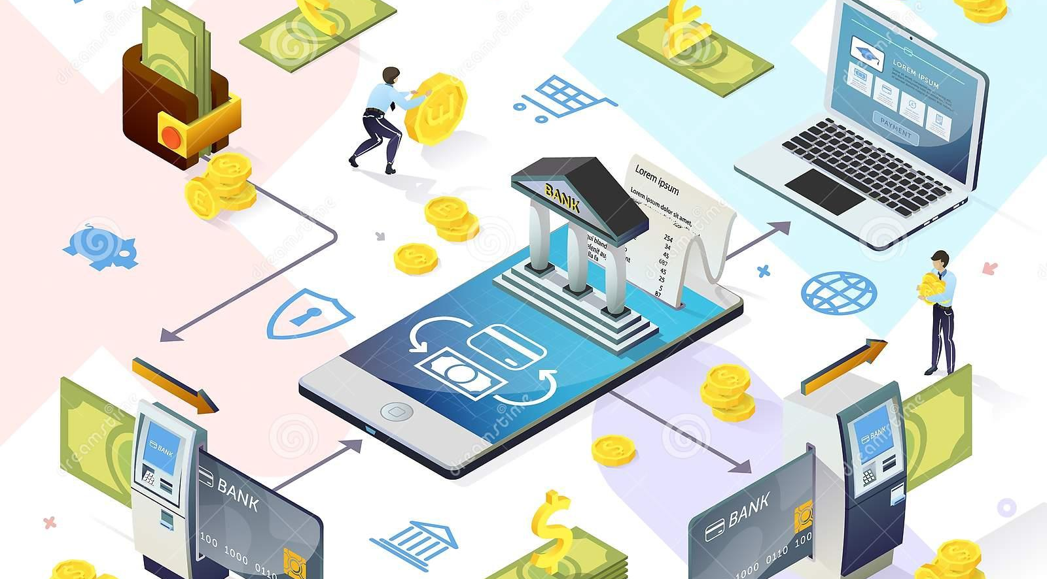
Vertex Bank Group
Banking for a New World!!

Slide 2
Presented by:
MADALA TRIVEDH
ASHISH J REDDY
ATREYA MAJUMDAR
VIGNESH SRINIVASAN
SHIVANGI SAHAY
Under the guidance of:
Rajashekar Sir

Slide 3

TABLE OF CONTENTS
Introduction.
Aim of the project.
Objective of the project.
System Requirements.
Technologies Used.
Project Modules
Screenshots of the project.
Advantages
Future Scope
Conclusion

Slide 4
INTRODUCTION
A bank is a financial institute which accept deposits from public, pay interest on pre-defined rates, make loans and often acts as an intermediary in financial transactions.
It also provides other financial services to its customers like making home loans, etc.
Lending activities can be directly performed by the bank or indirectly through capital markets.
Online banking which is also known as internet banking, web banking or home banking.
It is an electronic payment system that enables customers of a bank or other financial institutions to conduct a range of financial transactions through their website.

Slide 5
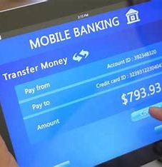
AIM OF THE PROJECT
To create an Online Banking Application that is a browser based Application to keep track of Account Details, Funds Transfer, Opening Fixed Deposit Account, Change the ATM Pin and informing about the Events that are taking place within the bank.
It should be an online responsive website which should be easily available to the customers on laptops, desktops,tabs and mobile phones.

Slide 6

OBJECTIVES
To Ease the Banking Experience
One of the most important objectives of online banking is to let our customers make transactions, deposit funds and open new bank accounts from the ease of their home without having to stand in long queues.
E-banking is helping the customers by providing online services. It attracts the customers and by making the banking system easier.
To Boost Economy
E-banking helps to boost the economy because online transaction helps to maintain the cash in the economy, which would be used during recession of the economy.

Slide 7

To Provide 24/7 Service
The world economy is growing, people are doing business globally thereby making them busy than regular.
It requires a 24*7 banking service. E-banking does the same i.e., it provides a 24*7 service thus making it an important objective.
To Maintain customer’s Belief
The money what the customer have in his account has to be protected, which is a security for the customer thus helping them not to get panic about their money.
To provide accessibility
Online Banking means accessing your bank account and carrying out financial transactions through the internet on your android devices. It's quick, usually free and allows you to do tasks, such as paying bills and transferring money, without having to visit or call your bank.

Slide 8

SYSTEM REQUIREMENTS
Windows 10
Processor Base Frequency of 1.8GHz or higher
4 GB RAM or more
7 MB of available disk space or more
Minimal Screen Resolution: 1366x768 pixels
Camera and Mic (USB Built In)

Slide 9
TECHNOLOGIES USED
HTML 5
CSS 3
Javascript
React JS 5.0 or above
Bootstrap 5.0 or above
JSON7
GIT & Github

Slide 10
PROBLEM STATEMENT
To create a responsive Online Banking Application that is a browser based Application to keep track of Account Details, Funds Transfer, Opening Fixed Deposit Account, Change the ATM Pin and informing about the Events that are taking place within the bank.

Slide 11
PROJECT MODULES
Registration
Login
New FD Account
Request Checkbook
Fund transfer
Change the ATM Pin

Slide 12
HOME PAGE
User can access various options here like login, register, transfer funds from one account to another and request a cheque book.
User can fill the application form for opening a new account, change the ATM Pin and open a new FD Account.
There is a separate page which contains the information about the various events happening and even users not holding an account with the bank can register for the same.
If the user logins through a social account then he will directly land to the Events Page.

Slide 13
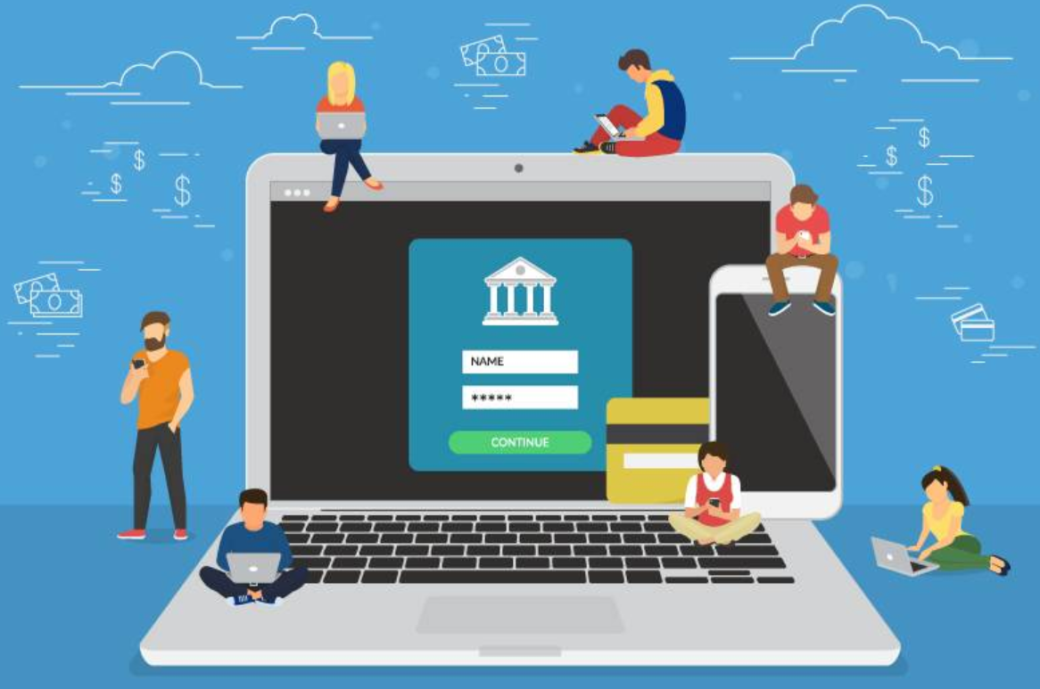
LOGIN PAGE
Through login page the user can enter their access details and explore the facilities available.
The access details include the User-Id and password which are created at the time of registration.
Upon validation,the user will be taken to the accounts page where he can see his details like balance in the account and links to other services for his account.

Slide 14
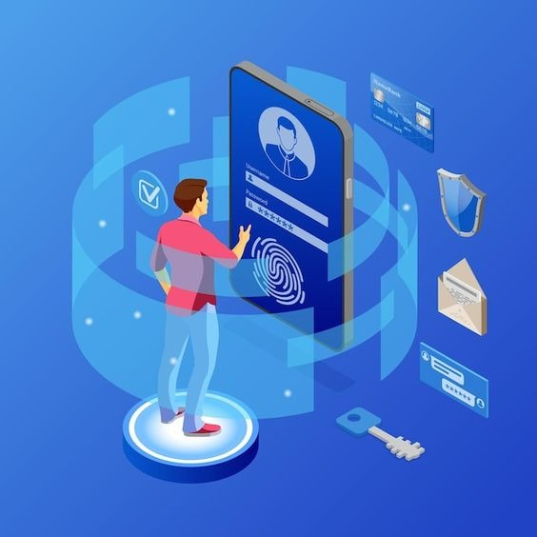
REGISTRATION PAGE
In the register page, the user should give his details for registration so that he can use the same details to access later.
He has to enter his email, password and transaction password which play a key role in later part of the transactions.
He can deposit the amount initially to start his services provided by Vertex Bank Group.
Also the user has to accept the terms and conditions provided by our bank so that he becomes a verified user.

Slide 15
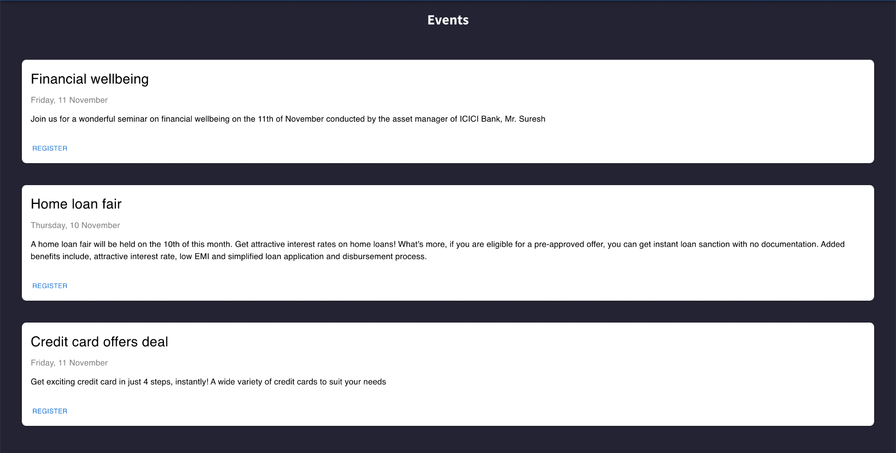
EVENTS TAKING PLACE

Slide 16
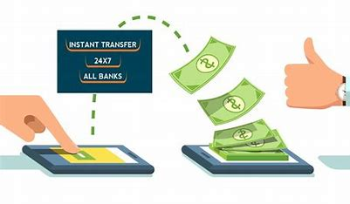
TRANSFER FUNDS
User will be able to transfer the funds to another account within the banking system.
Successful transfer of available funds to another account will be managed by making a call to API app.

Slide 17

OPEN NEW FD
User can be able to open a new Fixed Deposit for 3,6,9,12 months.
User should be able to choose from the option and select the FD product.
This page communicates to API which will deduct the amount of FD from his bank account and generate a new FD, which will be emailed to his bank account.

Slide 18
LOGIN AND REGISTER FOR EVENTS
User can register to attend the events organized by banks.
For this user can login from his/her social media account like gmail,linkedin,twitter etc.
User does not need to hold the bank account with the bank.
Thus this is an open invitation for the people who would want to get associated with the bank and explore the services provided by the bank.

Slide 19
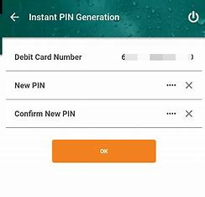
REQUEST FOR CHECKBOOK AND CHANGE ATM PIN
User can make request for a new cheque book and change/generate the ATM pin online.
They interact with WebAPI which collects the information from the user.

Slide 20

PROJECT SCREENSHOTS : (REACT BASED ONLINE APPLICATION)

Slide 21
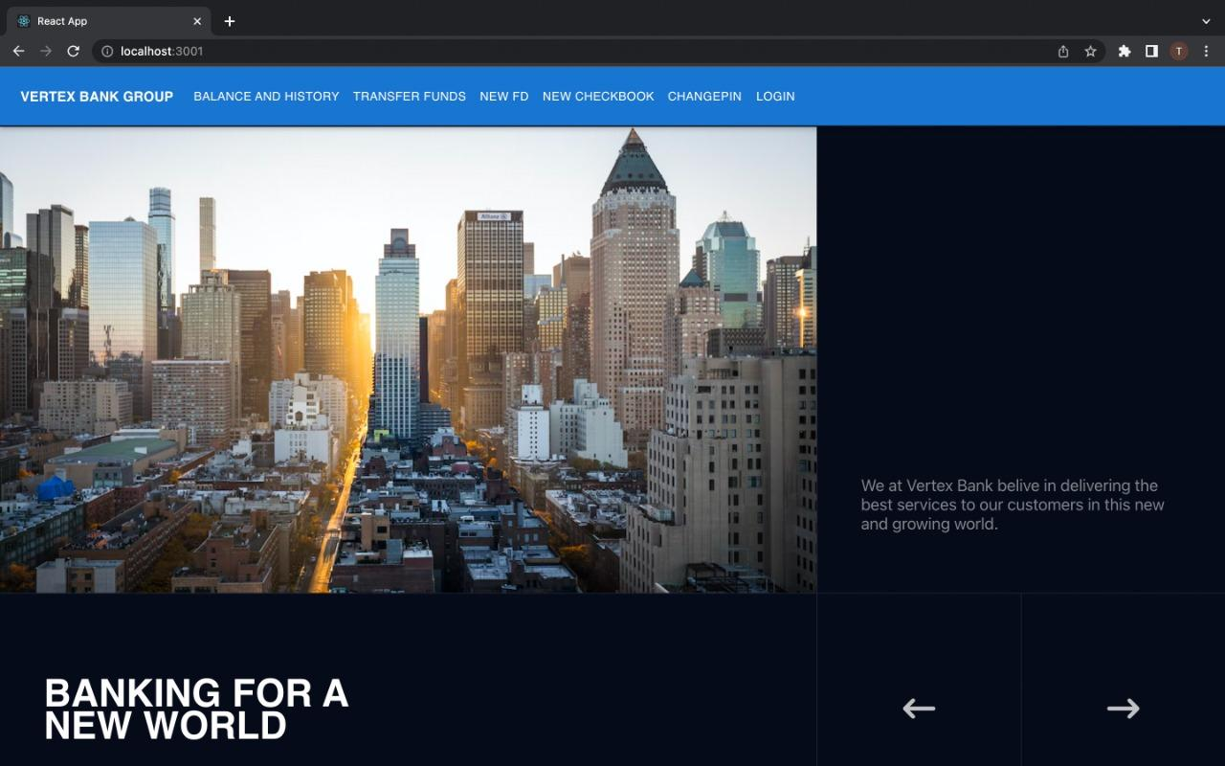
HOME PAGE

Slide 22
NAVBAR

Slide 23
FOOTER

Slide 24
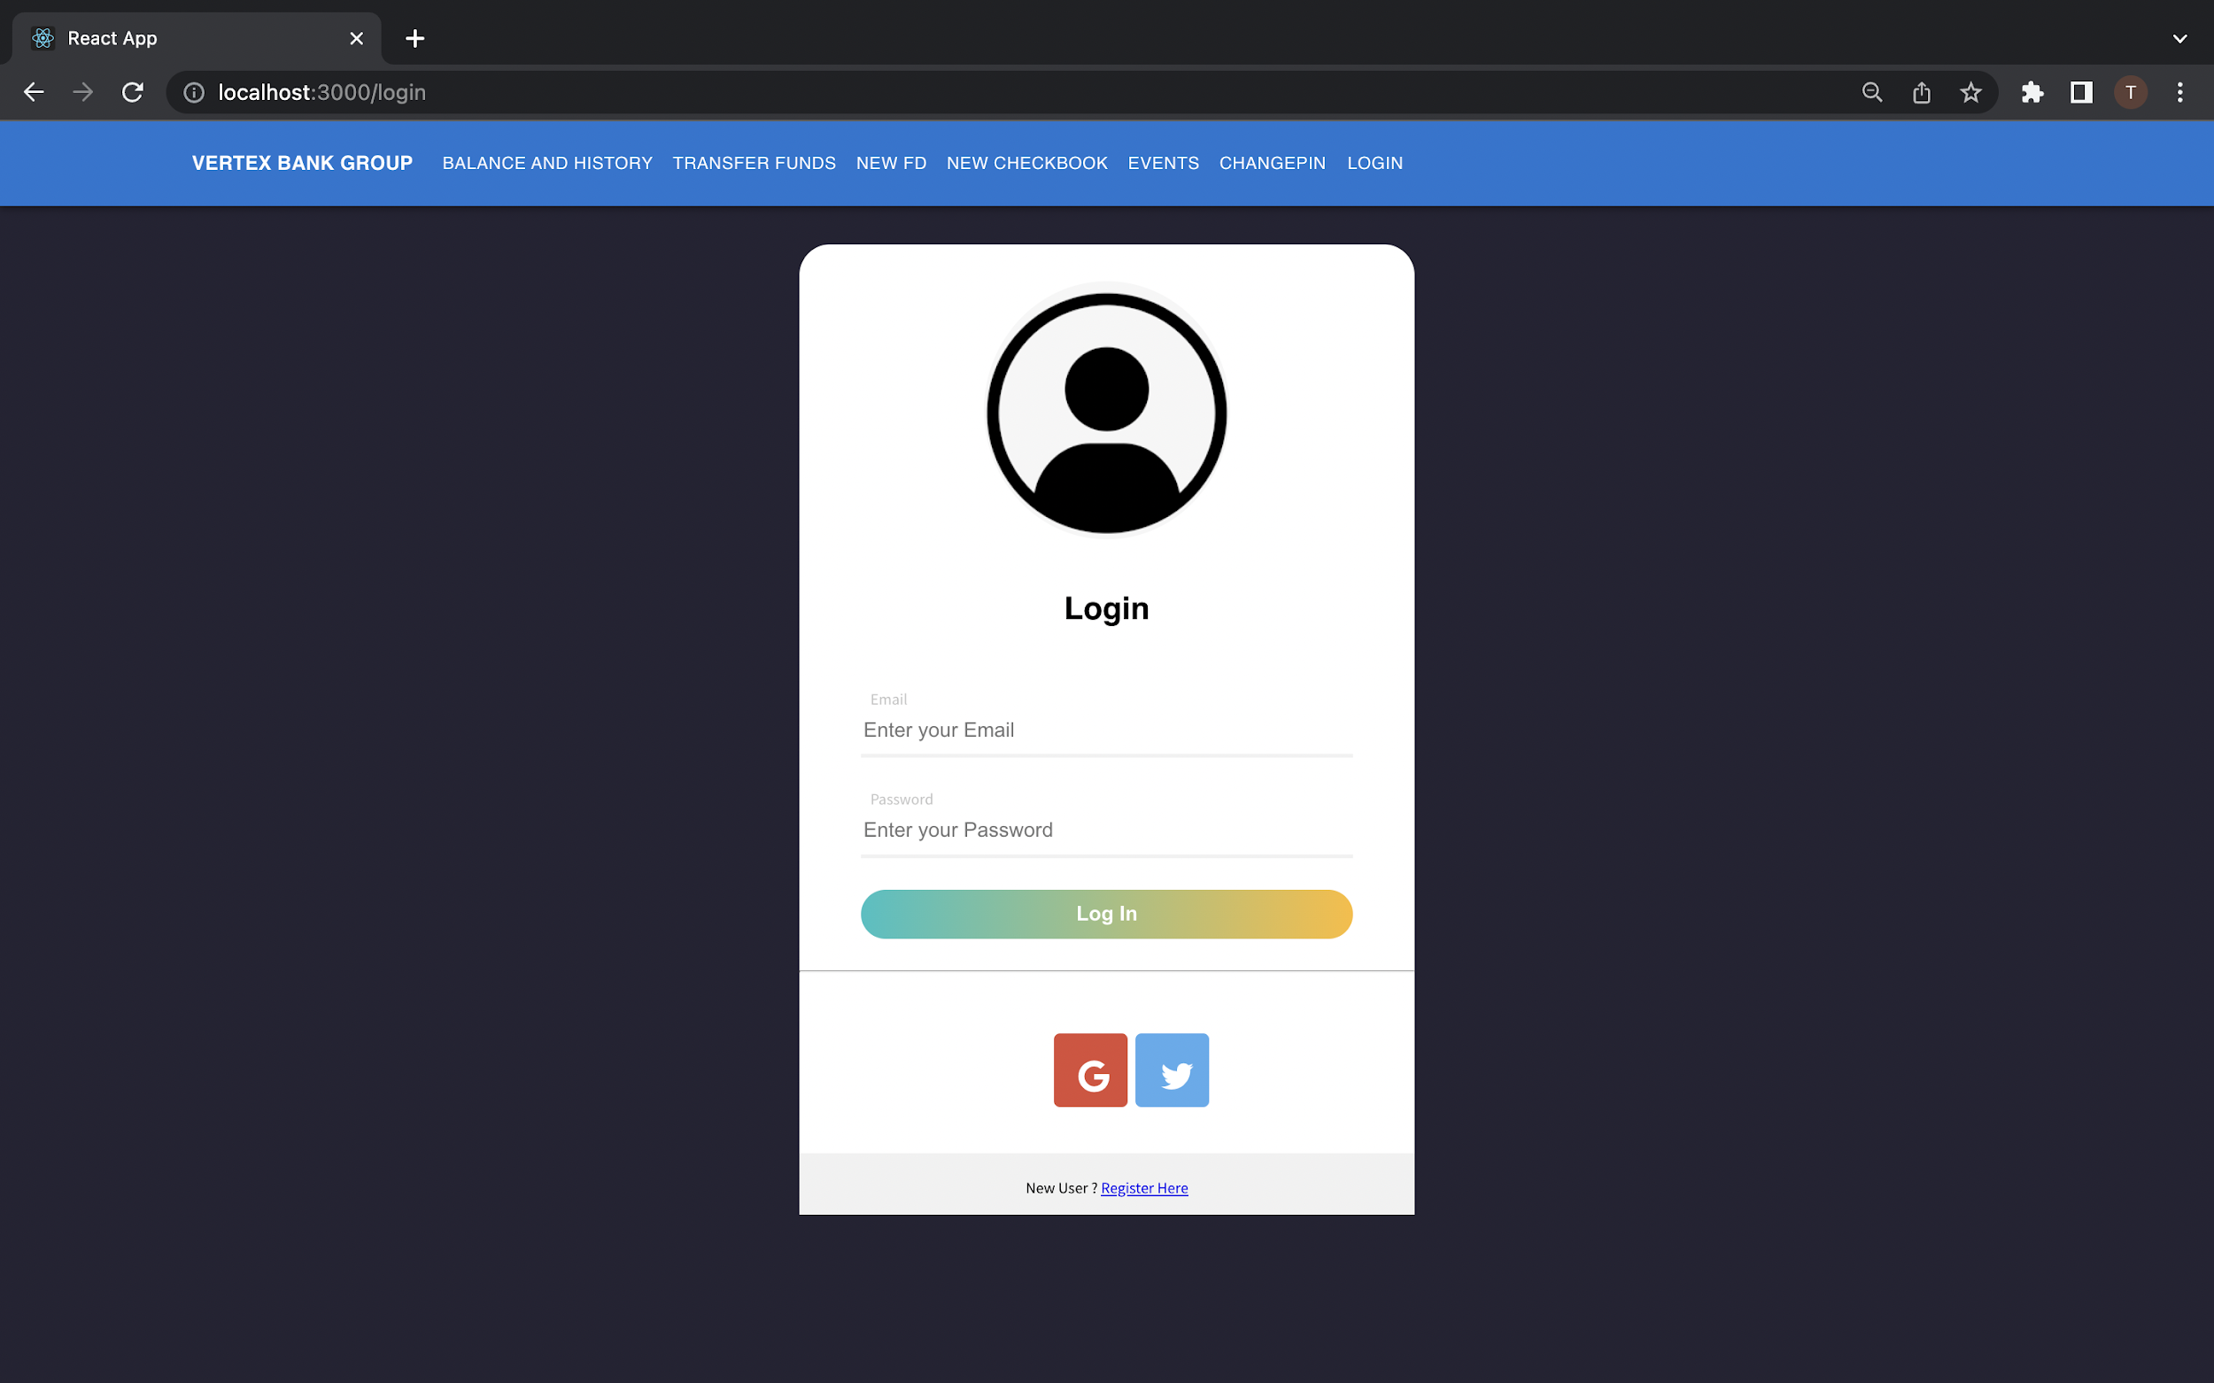
LOGIN PAGE

Slide 25
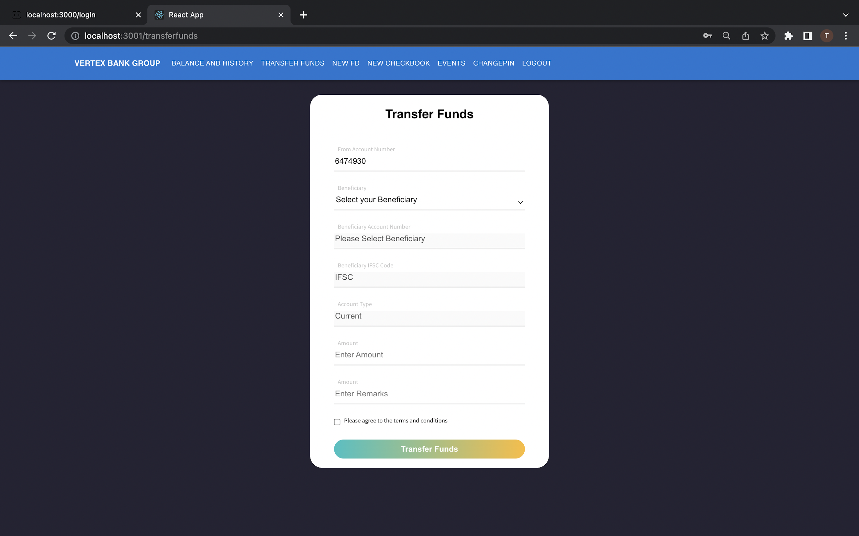
TRANSFER FUNDS

Slide 26
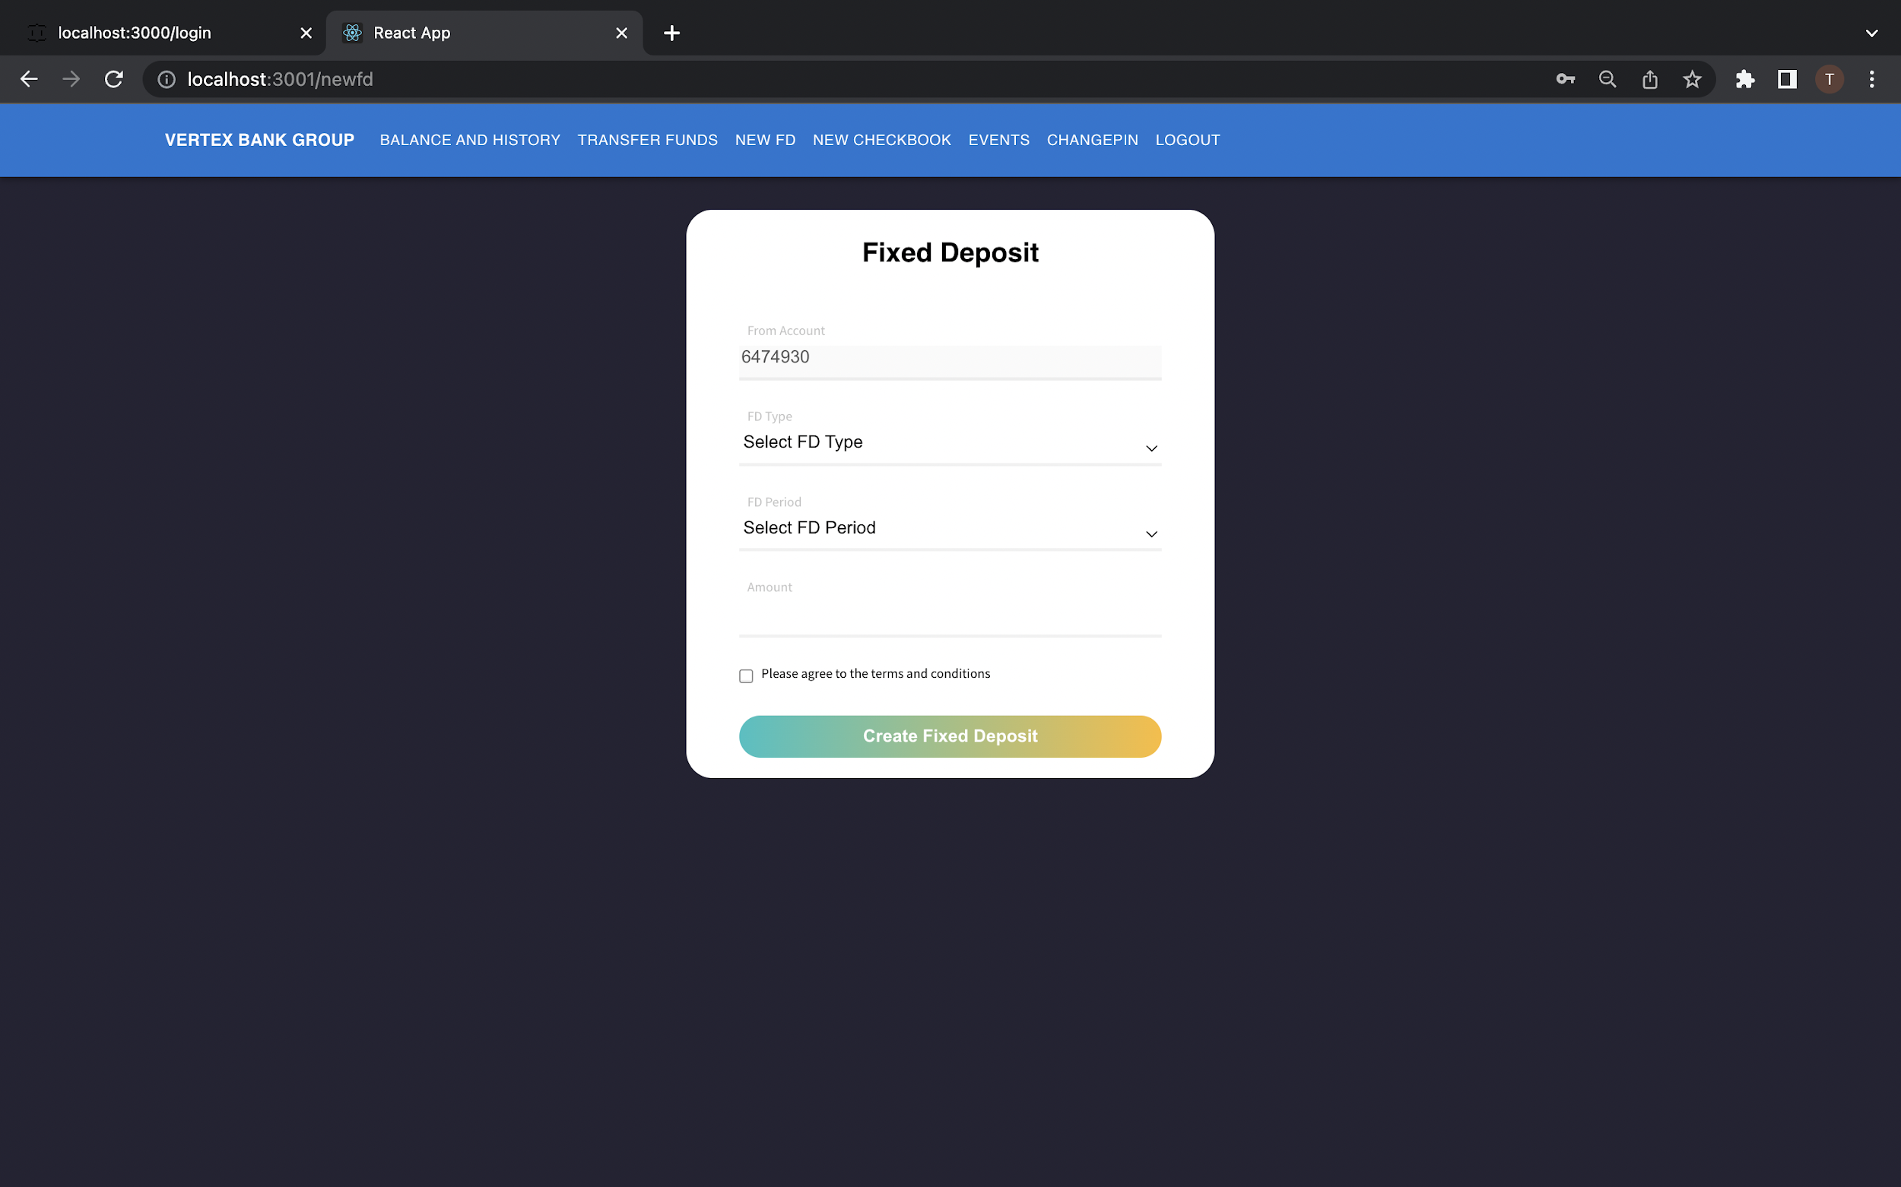
FIXED DEPOSIT

Slide 27
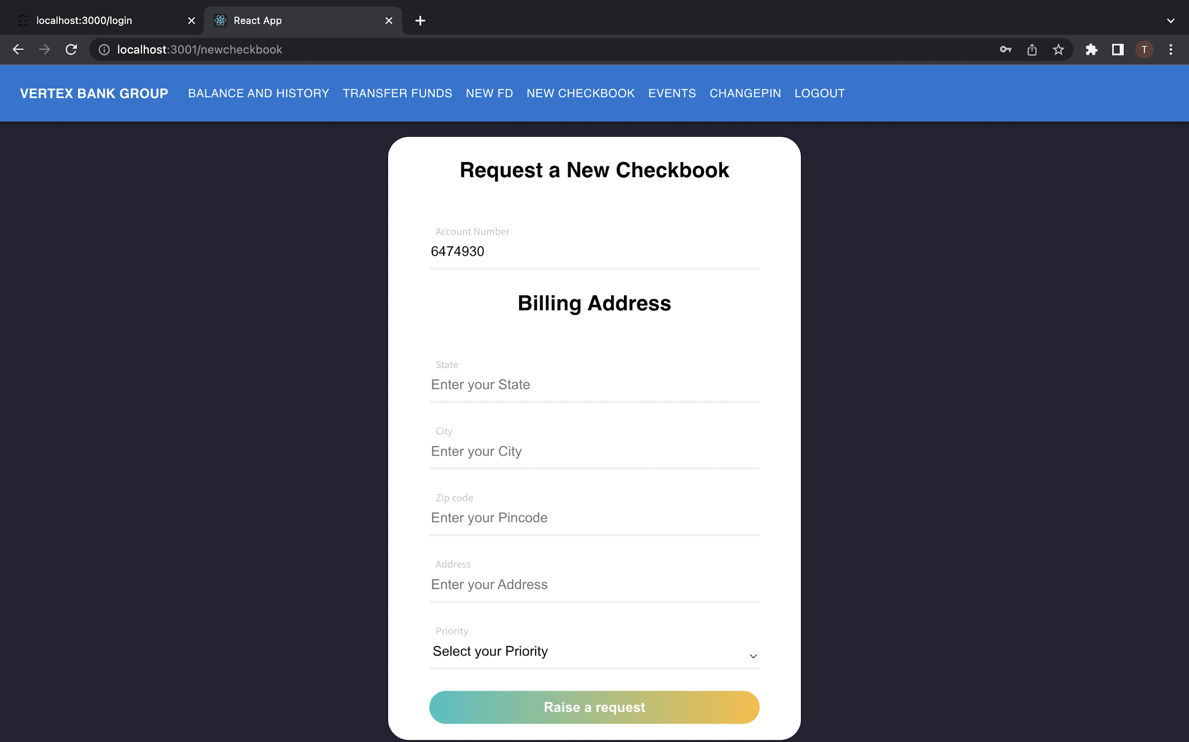
REQUEST A NEW CHEQUE BOOK

Slide 28
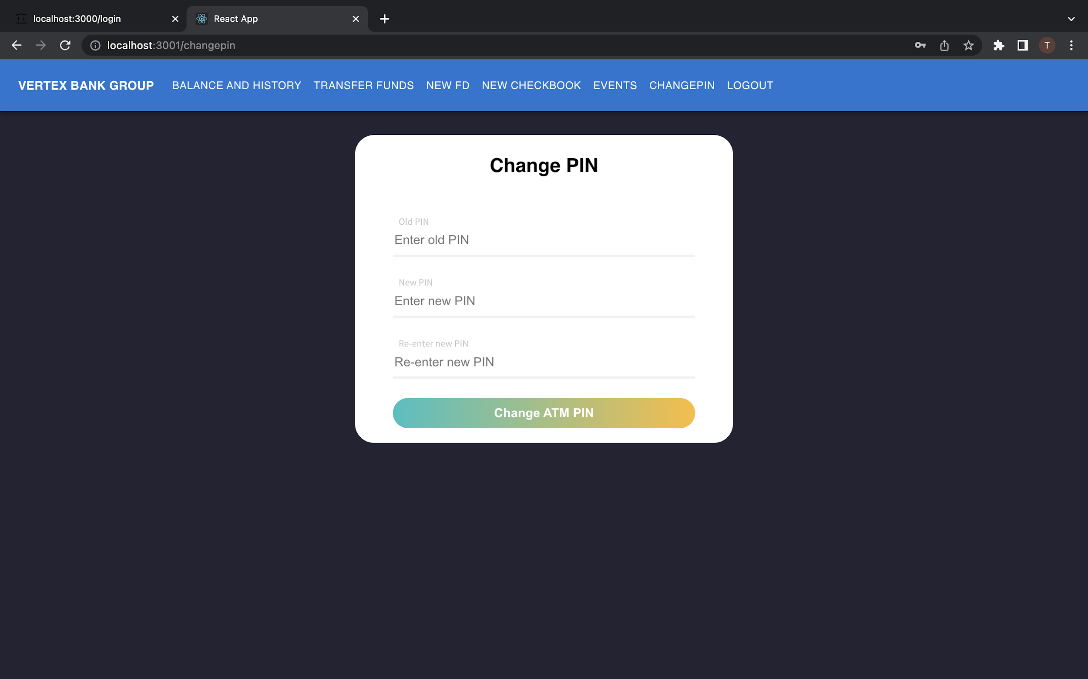
CHANGE ATM PIN

Slide 29
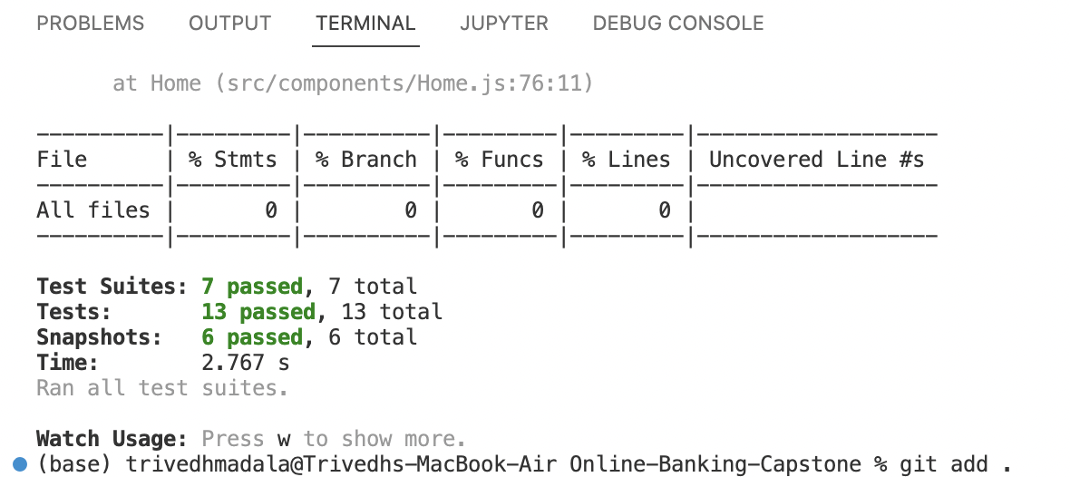
Test Results (Jest)

Slide 30
FUTURE SCOPE
Can Implement applying for Home loans,Gold loans and Car loans.
Credit Card applications can be implemented.
UPI,RTGS and NEFT transactions can also be applied.
Transaction Details displayed on the admin dashboard.
Online Shopping.
Online Payments.
Opening for PPF accounts and other tax benefit accounts can also be implemented.

Slide 31
ADVANTAGES
Opening of digital account
Transferring Funds
Transfer of funds from one account to another
Open fixed deposit and recurring deposits online
Applying for request of cheque book
Changing the ATM Pin online
Access your account 24/7
Investing in mutual funds.

Slide 32
CONCLUSION
This Web Application facilitates online banking where lots of bank related activities can be done with the ease from anywhere and it saves a lot of time.
Can do banking at ANY Time and Any Where.
It can be said as a Mobile form of banking..!!

Slide 33
THANK YOU

